Slide 1
ISM 6136
Data Mining
Dr. Tim Smith

Slide 2
Guiding Agenda
08:30-08:35 - Class Agenda
08:35-08:45 - Introductions
08:45-09:05 - Review syllabus
09:05-09:10 - First-day attendance quiz
09:10-10:00 - Introduction to Analytics and Data Mining
Rationality in decision making
The rise of analytics
Models and modeling
10:00-10:10 - Break
10:10-10:25 - Introduce DataCamp, get everyone signed up
10:25-10:50 - Install Anaconda, and demonstrate how to manage packages
10:50-11:10 - Introduction to Jupyter lab and markdown language.
11:10-11:20 - Submit Jupyter Lab Verification (your first notebook)
11:20-11:30 - Class recap, questions, deliverables this week, and preparing for next class

Slide 3

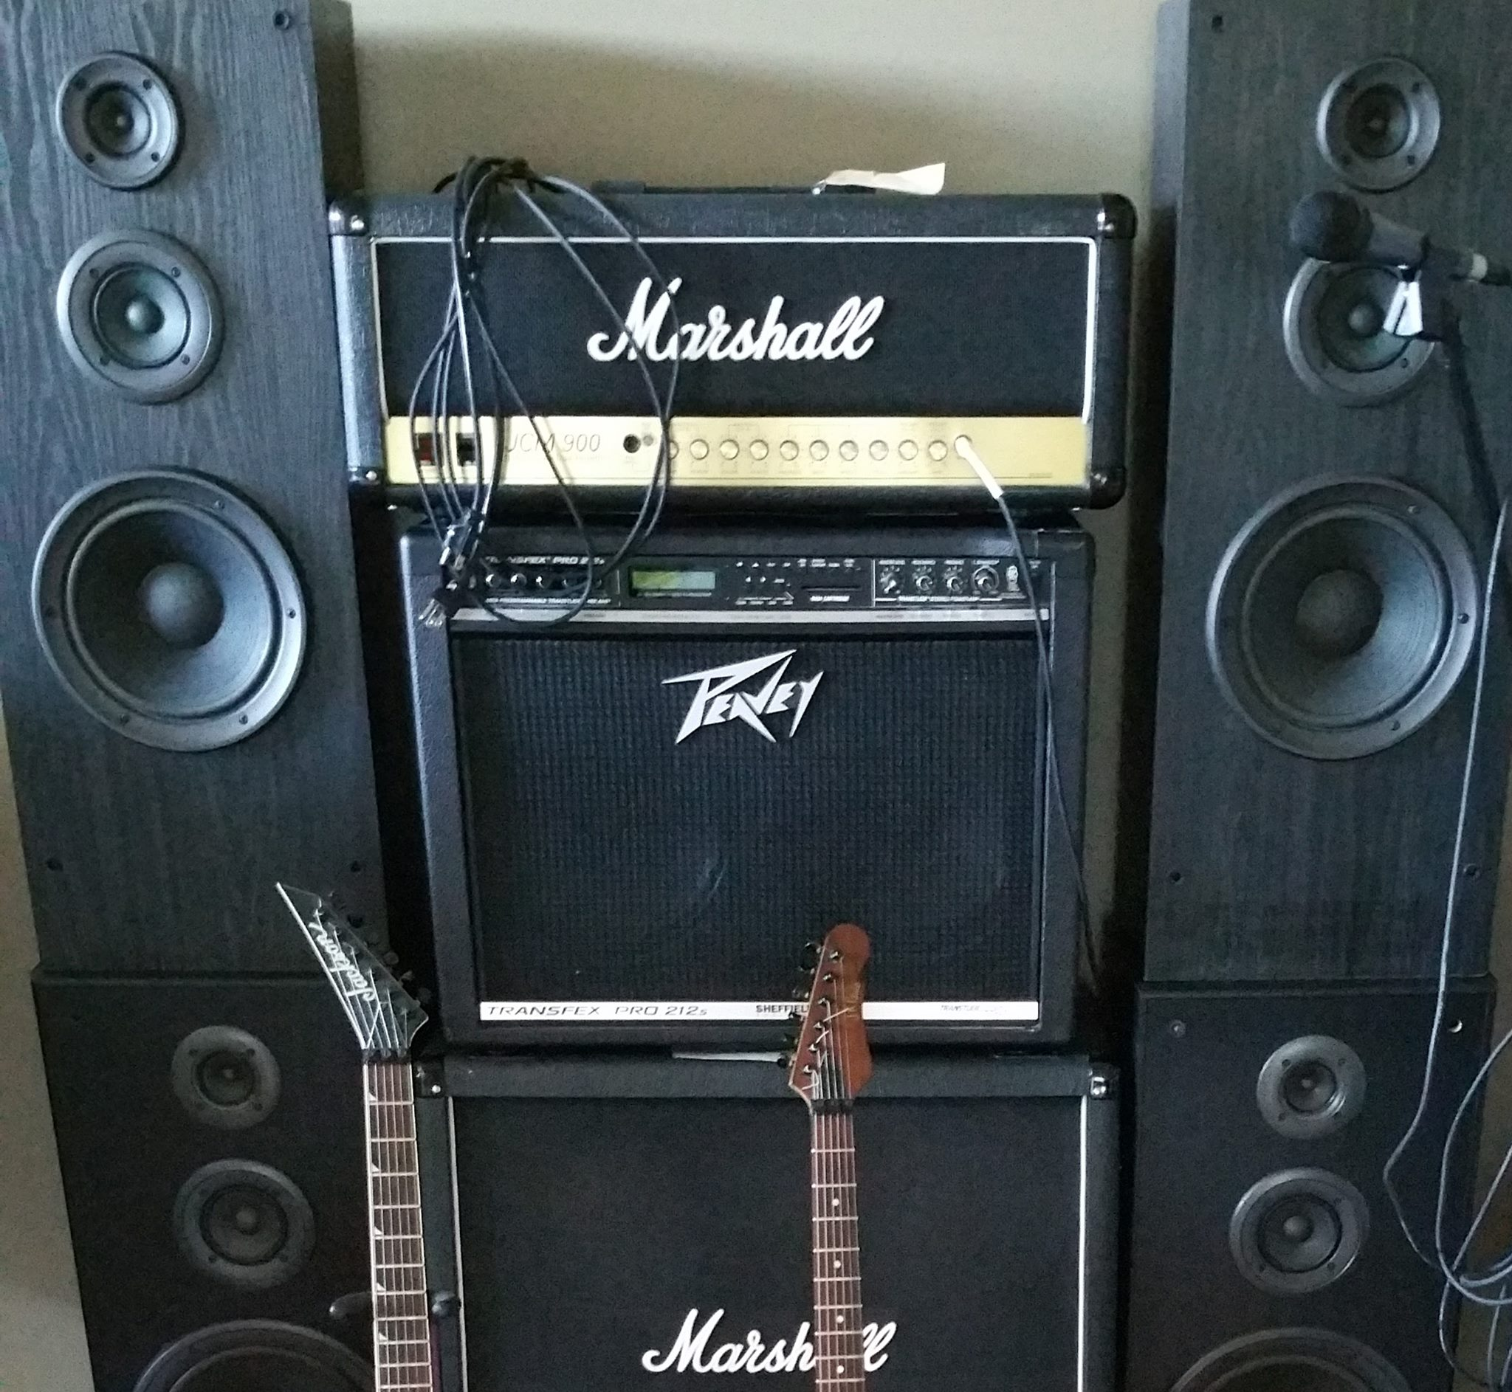
Meet your professor
Dr. Tim Smith
PhD in Business Information Systems
Research Interests include technology adoption , organizational routines, health information technology, and application to deep learning models to cryptocurrency and blockchain. Coauthoring a textbook on Business Analytics (Prospect Press).
20+ years of professional experience
Systems programmer
Founder, and president of a software development company
Systems Architect
Telecom Executive
In my spare time, I like to travel, hike, fly-fish, and play guitar.

Slide 4
Introduce Yourselves
Introduce yourself to at least one person next to you (left, right, front, or back)
Tell them your name, and one interesting thing about yourself:
i.e., mine was that I played lead guitar in a heavy metal band
NOTE: You don’t need to limit yourself to one introduction

Slide 5
Course Introduction

Slide 6
ISM6136 – Syllabus Review
Review Syllabus
Review Academic Integrity Policy (Cheating)
Statement on ChatGPT
Review Canvas and how to navigate course content
First-day attendance quiz

Slide 7
Rationality in decision making

Slide 8
Learning Objectives
Understand empirical vs theoretic approaches
Understand the idea of satisficing, and the constraints managers face on making ‘rational decisions’
Understand the impact of beliefs on matching truth to findings
Understand two key strategies for increasing ‘rationality’ in decision making.

Slide 9
Let’s begin
Let’s focus on some of the philosophical fundamentals of what we’re trying to accomplish when we attempt to conduct business analytics.
Much of what we’re trying to do is to have some sense of what the future holds, and what effects our decisions will have on that future….

Slide 10
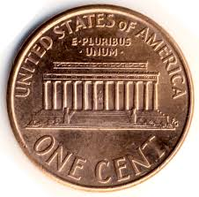
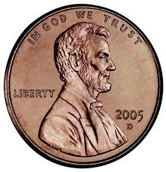
Coin Flip
Heads
Tails
Tails
Tails
Tails
Notes:
Typical answer a student will give is that the chance of getting Tails on the next flip is 50%
This answer exhibits an underlying assumption (model) – that the coin is a fair coin (in most cases, this is a reasonable assumption).
Considering the sequence we see here - Is the coin (or my algorithm used to flip the coin) fair?

Slide 11
Two perspectives:
Two people watch this same sequence of coin flips. The person flipping the coin then asks the first person “What will the result of the next coin flip?”
The first person responds: “These are independent events, and each coin toss have is 50/50 chance for heads or tails.”
The coin flipper then turns to the second person and asks the same question. The second person says, “obviously you have a trick coin, so it will most likely be tails”.
Discussion: Who is right?
Notes:
To explore this, we think in terms of how many possible combinations of 5 flips has 1 head out of 5. The chance of getting only one head in 5 (if the coin was fair) is 5/32, or 15.625% (odds of 1 in 6 are 6/64 9.4%, odds of 1 in 7 are 5%, etc.) At what point should we say the coin isn’t fair or is fair?
All combinations are equally likely
10101 has the same probability of occurring as 00000, but we can often think of some outcome as special when it’s not
A few take-a-way points:
There are statistical methods to determine if a coin is fair - a frequentist approach, and a Bayesian approach. But each of these requires us to experiment with the coin.
In this scenario, we don’t get to experiment with the coin. The data is what it is.
The sample is so small (5 flips) we can’t answer this question.
If we had a large enough sample, even without the possibility of experimentation, we could possibly answer this question.
In business, we often do not have the luxury of re-running a process – i.e. we can’t rerun last year’s sale process 10 times; we are stuck with the data we have, and we need to answer questions only using this data.
But we need to be careful – even with large data sets, we may be unable to predict an outcome…. See the next slide for example…

Slide 12

What about this Case?:
During World War II, researchers at the Center for Naval Analysis faced a critical problem. Many bombers were getting shot down on runs over Germany. The naval researchers knew they needed hard data to solve this problem and went to work. After each mission, each bomber’s bullet holes and damage were painstakingly reviewed and recorded. The researchers poured over the data looking for vulnerabilities.
The data began to show a clear pattern (see picture). Most damage was to the wings and body of the plane.
What does this analysis indicate?
Syed, Matthew. 2015. Black Box Thinking. New York: Penguin Random House. pp 33-37

Slide 13
What can we learn from these cases?
The Coin Flip Case:
This is an illustration of philosophical orientations we have about the world, and its consistencies. The second person is illustrating a more empirically based perspective – showing an inclination to give “what is observed” precedence over “what is supposed”, thus drawing theory from evidence. The first person, however, is showing a tendency to give precedence “what is supposed” (aka theoretical based perspective), over “what is seen”, therefore fitting theories to what is observed.

Slide 14
What can we learn from these cases?
The Military Plane Case:
They were attempting to predict the occurrence of an incident (plane is shot down) without having data on any cases of this! The were drawn to the prevalence of data, but lost sight of its relevance to the question.

Slide 15

Decision Making and Problem Solving in Business
In business, we analyze data to gain information to improve outcomes through better (more informed) decision-making.
a choice that you make about what actions you will take (or not take) in a given situation.
A good decision is one we’d classify as a rational decision.
After analyzing the consequences of each option, a rational decision-maker will choose the option that generates the greatest utility (benefit, in whatever form it is measured)

Slide 16
Rational Choice Theory
Rational choice theory is an economic theory (principle) that states that individuals always make prudent and logical decisions. Given the choices available, these decisions provide people with the greatest benefit or satisfaction and are also in their highest self-interest.
But why are so many business decisions seemingly irrational?

Slide 17
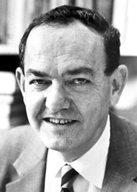
Bounded rationality
The rationality of individuals is bounded (limited) by
cognitive capacity
time (budget)
limited knowledge/access to information
Satisficing
Satisficing is a decision-making strategy that entails searching through the available alternatives until an acceptability threshold is met.
Herbert Simon
(1916-2001)
Our models and the assumptions we use in such decision-making processes can’t always be correct, as they are the product of a satisficing process.

Slide 18
So, the question is: How tightly should we “tie ourselves to the mast”?
We maintain certain beliefs, or models, about this world.
These models are created through past experience and are not normally developed using rigorous analysis.
When faced with a novel situation – past assumptions/models can often produce invalid or contradictory results to what we are seeing.
At what point do we develop new assumptions, or models, to explain what we are seeing?

Slide 19
The BDT Framework: Beliefs, Discoveries and the Truth
BELIEFS
TRUTH
A finding that is true and you believe it – Great! This is where we want to be in Data Analytics
FINDINGS

Slide 20
The BFT Framework: Beliefs, Findings, and the Truth
BELIEFS
TRUTH
Error 1: You believe an untrue finding
Error 2: You don’t believe a true finding
FINDINGS

Slide 21

“People…operate with beliefs and bias. To the extent you can eliminate both and replace them with data, you gain a clear advantage.”
Michael Lewis, Moneyball: The Art of Winning an Unfair Game

Slide 22
Increasing ‘rationality’ - moving from ‘gut feel’ to systematic analysis
Many managers operate on ‘gut feel’:
As business analytics professionals, you will face this.
Utilize data and modeling techniques to systematically evaluate outcomes.
Avoid seeing False findings as True
Avoid seeing True findings as False
In this course you will gain knowledge and experience in using data mining techniques to improve the quality of business decisions.
Keep an open mind
Become proficient in the techniques of DM
Get a Masters in Business Analytics ☺

Slide 23
The Rise of Analytics

Slide 24
Learning objectives
Understand what Solow’s Paradox is/was, and how this is changing in today’s data driven world.
Understand big data, and the 3+v’s
Situate Data Mining and Data Analytics within the large scope of data science.
Describe the four types of data analytics.
Describe some examples of the use of data analytics in business.

Slide 25

1987….
“You can see the computer age everywhere but in the productivity statistics“.
Robert Solow, 1987

Slide 26

Today…
Since 2002, the top 5% of companies have increased productivity by 40%, while the other 95% of companies have barely increased productivity at all.
Andy Haldane, Chief Economist for the Bank of England

Slide 27
What explains this?
Some companies have found a solution to Solow’s Paradox and are rapidly improving their productivity.
Economists continue to explore what’s behind this trend, but a few things are clear
The Internet is increasing the rate of consolidation in many industries.
Differentiation is even more important today!
Effective use of data analytics and machine learning are being leveraged to improve and automate business processes and decision making.
Clearly, some companies do a better job at this than others!

Slide 28
Data data everywhere…
2.5 quintillion bytes of data generated each day
Over the last two years, we’ve generated 90% of all the data that has ever been generated!
We conduct more than half of our web searches from a mobile phone now.
More than 3.7 billion humans use the internet (that’s a growth rate of 7.5 percent over 2016).
On average, Google now processes more than 40,000 searches EVERY second (3.5 billion searches per day)!
See the infographic here (https://web-assets.domo.com/blog/wp-content/uploads/2017/07/17_domo_data-never-sleeps-5-01.png)

Slide 29
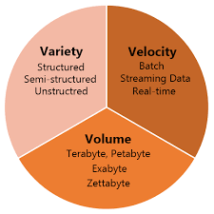
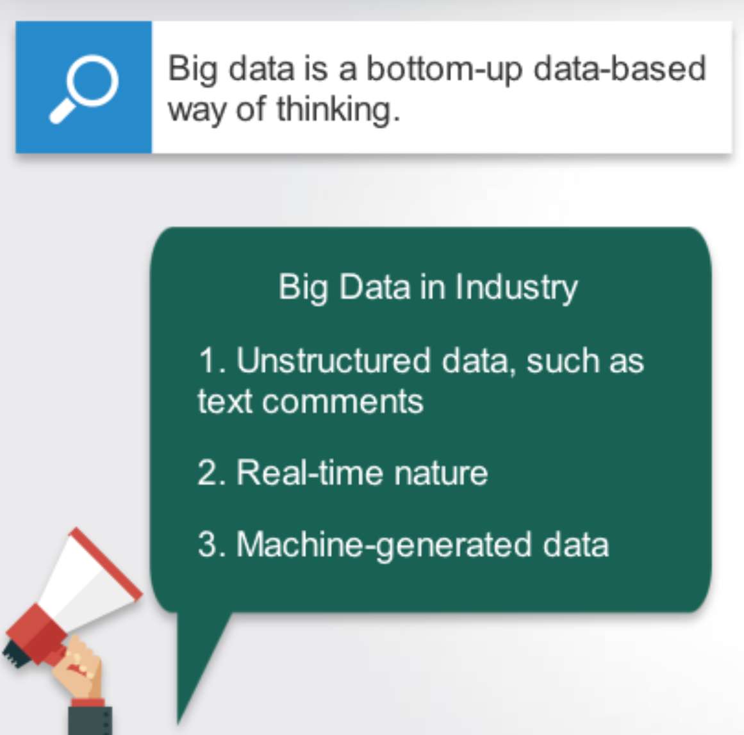
Big Data

Slide 30
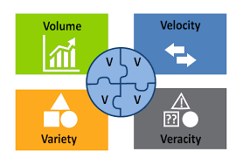
Other Systems: Big Data – 3Vs and 4Vs

Slide 31
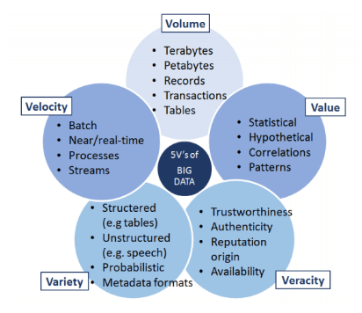
Other Systems: Big Data – 5 Vs

Slide 32
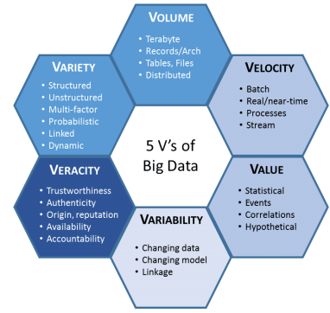
Other Systems: Big Data – 6 Vs
6 V’s of Big Data
Note: Some experts have kept adding new V’s (i.e., 17!) – but beyond 6 is probably not necessary or valuable.

Slide 33
What is Data Analytics?
Analytics is the use of:
data,
information technology,
statistical analysis,
quantitative methods, and
mathematical or computer-based models
to help managers gain improved insight about their business operations and make better, fact-based decisions

Slide 34
Scope of Analytics
Descriptive analytics: What happened?
- uses data to understand past, answers the questions what happened and why did it happen
Diagnostics Analytics: Why did this happen?
- uses data to infer the antecedent factors that caused some outcome to happen
Predictive analytics: What could happen?
- utilizes statistical and machine learning techniques to make predictions about the future
Prescriptive analytics: What should we do?
- often uses optimization techniques, provides recommendations of actions that will take advantage of the predictions

Slide 35
What is Data Mining?
Data mining is the process of searching and analyzing a large batch of raw data to identify patterns and extract useful information.
Companies use data mining software to enhance decision making
Data mining enables businesses to unearth hidden patterns and relationships within large datasets. These insights can help in making data-driven decisions that are strategic and aligned with the organizational goals.

Slide 36
Application | Business Problem | Prediction Goal
Credit Scoring | How to assess and control risk within existing (or new) consumer portfolios? | Measure credit worthiness of new and existing set of customers
Market Basket Analysis | How to increase sales with cross-sell/up-sell, loyalty programs, promotions? | Which products are likely to purchased together?
Asset Maintenance | How to minimize operational disruptions and maintenance costs? | Identify real drivers of asset or equipment failure. Optimize asset life maintenance and replacement.
Health & Condition Mgmt. | How can we reduce healthcare costs and satisfy patients? | Identify patients at risk of a chronic illness & offer treatment program
Fraud Mgmt. | How to decrease fraud losses and lower false positives? | Detect unknown fraud cases and future risks
Drug Discovery | How to bring drugs quickly and effectively to the marketplace? | Find compounds that have desirable effects & detect drug behavior during trials

Slide 37
Models and Modeling

Slide 38
Learning Objectives
Understand what data models are
Relate data modeling to answering questions from data
Identify common errors we find in data modeling

Slide 39
Models
“A system of postulates, data, and inferences presented as a mathematical description of an entity or state of affairs”¹
Which of the following could we consider a “model”
y = 2x + 3
Yes, given a value (we’ll label as x), we can determine another value (which we label as y).
Color is red if x is 1, otherwise color is blue
Yes, given a value (we’ll label as z), we can determine an associated color.

Slide 40
Predictive Models
Much of this course will be dedicated to looking at predictive models.
In predictive modeling, we use various methods to identify patterns from past data and from this develop models to help predict future outcomes.
Let’s look at an example…

Slide 41
Classification Modeling Example: Riding Lawn Mower Ownership
Income | Lot_Size | Ownership
60 | 18.4 | Owner
85.5 | 16.8 | Owner
64.8 | 21.6 | Owner
61.5 | 20.8 | Owner
87 | 23.6 | Owner
110.1 | 19.2 | Owner
108 | 17.6 | Owner
82.8 | 22.4 | Owner
69 | 20 | Owner
93 | 20.8 | Owner
51 | 22 | Owner
81 | 20 | Owner
75 | 19.6 | Nonowner
52.8 | 20.8 | Nonowner
64.8 | 17.2 | Nonowner
43.2 | 20.4 | Nonowner
84 | 17.6 | Nonowner
49.2 | 17.6 | Nonowner
59.4 | 16 | Nonowner
66 | 18.4 | Nonowner
47.4 | 16.4 | Nonowner
33 | 18.8 | Nonowner
51 | 14 | Nonowner
63 | 14.8 | Nonowner

Slide 42
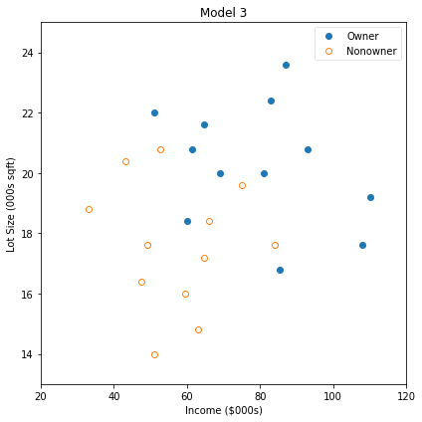
Our data

Slide 43
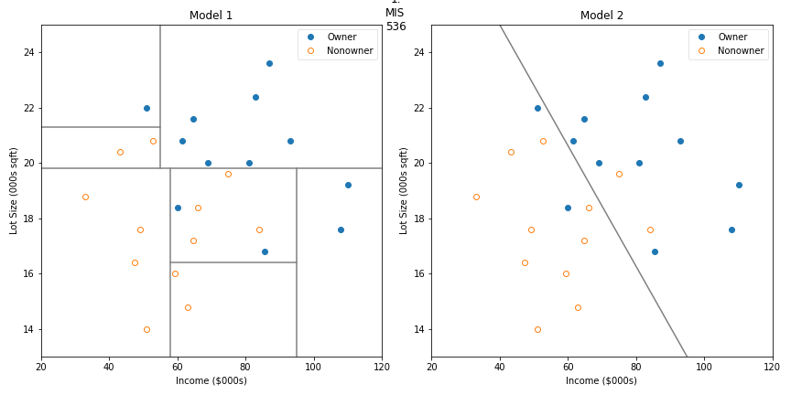
Classification Models

Slide 44
Classification Models

Slide 45

Models: The map, not the territory
“All models are wrong, but some are useful”
When we apply models to predict something in the “real world”, all models will have some level of error.
Errors in measurement
Errors in Data
Unmeasured/accounted for influences
Randomness
Dr. George Box
(18 October 1919 – 28 March 2013)

Slide 46
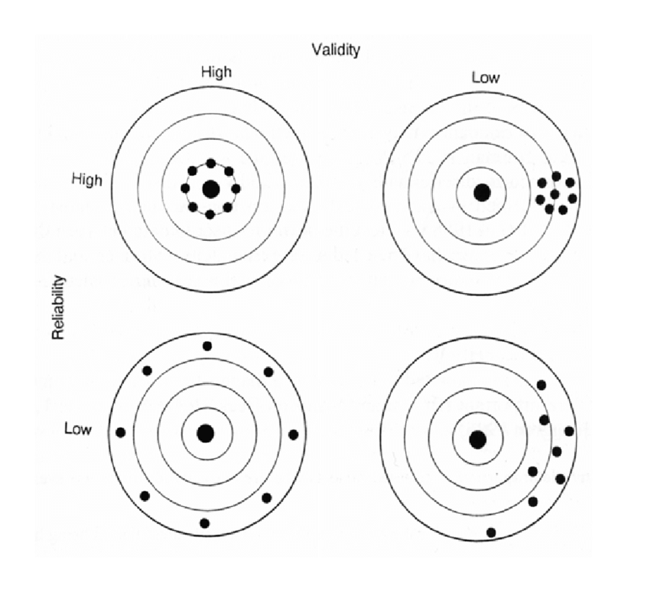
Errors in Measurement
Valid?
Are you measuring what you think you are?
Reliable?
Is your measure a reliable measure of real conditions (is it accurate)?

Slide 47
Errors in Data
Data can be corrupt, mismanaged, or missing.
Date | Temp
 | High | Low
January | 36 | 20
February | 32 | 15
March | 43 | 25
April | 65
June | 77 | 49
July | Ab#4a~ | 55
September | 85 | 54
October | 67 | 40
November | 56 | 21
December | 44 | 19
Missing value
Aug. and May?
Corrupt value

Slide 48
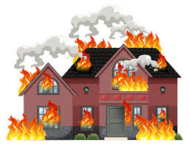
Unmeasured/accounted for influences
Date | Insurance claim | Firemen dispatched
1/5/2020 | $20,020.00 | 8
2/5/2020 | $100,000.00 | 12
3/5/2020 | $3,000.00 | 3
4/5/2020 | $23,478.00 | 8
5/5/2020 | $234,776.00 | 14
6/5/2020 | $200,500.00 | 13
7/5/2020 | $1,220,500.00 | 30
8/5/2020 | $30,000.00 | 14
9/5/2020 | $5,690.00 | 3
10/5/2020 | $456,231.00 | 18
11/5/2020 | $30,000.00 | 12
12/5/2020 | $890,900.00 | 23
13/05/2020 | $760,000.00 | 27
14/05/2020 | $49,000.00 | 12
15/05/2020 | $86,000.00 | 10
16/05/2020 | $389,000.00 | 23
Why is this model wrong?
y = 1715.3x² - 13623x + 21404 R² = 0.9011
# Firemen
Cost
Unaccounted for Factor!
(a spurious correlation)
# Firemen
Cost
Size of fire

Slide 49
Randomness
You may have here the term “Signal in the Noise”
With data mining, we often attempt to find some ‘signal’ in the noise of the data.
If there is no signal and all noise (randomness), modeling such data isn’t much value.

Slide 50
How do we handle random “noise”
Recognize that randomness exists
“overfitting” a model may make it fragile
Make sure there are no patterns in the noise
If there were patterns, it wouldn’t be random noise.
Don’t find patterns that are not there
Don’t fit your model to match the random noise
Measure the performance of the model
In the practice, models are never 100% accurate

Slide 51
DataCamp

Slide 52
Data Camp
Accept invitation and create account using USF email
To verify you have successfully created your account, take the Understanding and Interpreting Data assessment
…your performance on this is not graded – completing it results in full marks)

Slide 53
Python, Jupyter Lab & Anaconda

Slide 54
Learning Objectives
Understand why Python in Data Analytics
Understand how to create, load, and edit Jupyter Lab Notebooks
Be able to navigate within a notebook – change cell types, create new cells, delete cells, copy and paste cells, and move cells.
Know markdown language.

Slide 55
Anaconda and Jupyter Lab
Download and install Anaconda
Run Jupyter Lab
Follow along with professor
Create and submit installation verification assignment to Canvas.
Question: Does anyone know how they came up with the name “Jupyter”?

Slide 56
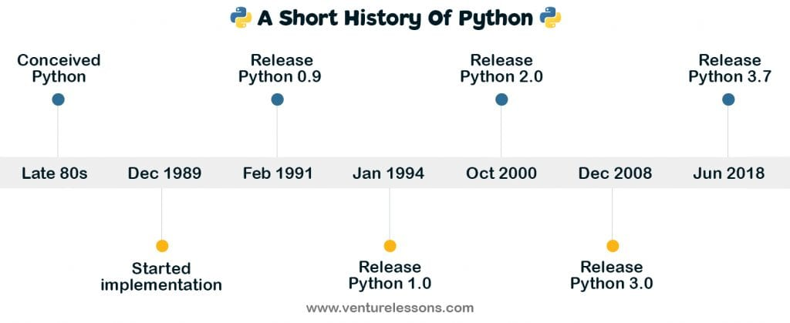
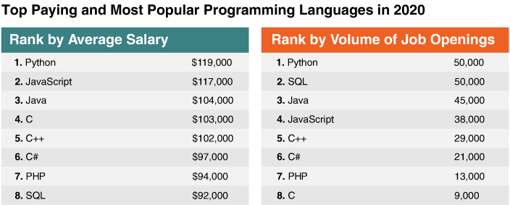
Python
Python is an object-oriented scripting language that is easy to read, write, and maintain and is a free, open-source tool.
Conceived by Guido van Rossum
Monty Python, not Snake
Used Extensively in Data Analytics

Slide 57
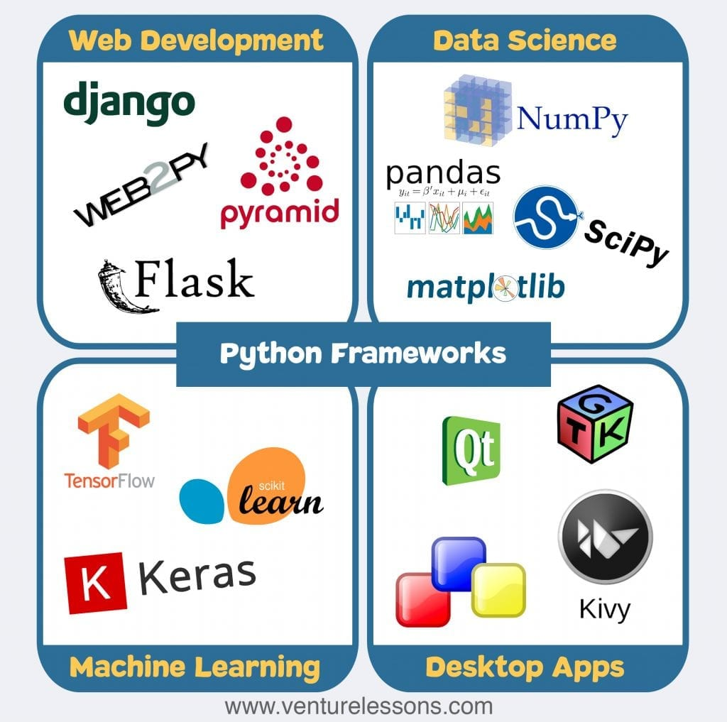
Python Frameworks & Libraries
We will primarily work with NumPy, Pandas, Matplotlib, and SciPy
NumPy - Vectors , Linear Algebra simulation
Pandas – Data Wrangling/Munging
Matplotlib – Visualizations/plotting
SciPy – Developing, testing, and deploying models

Slide 58
Jupyter Notebooks
Jupyter: A browser-based application that allows you to create and share documents (i.e. Jupyter Notebook files) that contain live code, equations, visualizations and narrative text.
Began as iPython, with support only for Python
Jupyter supports over 100 other languages
Java, R, Julia, Matlab, Octave, Scheme etc.
Jupyter Lab is a ground-up rewrite of Jupyter
It provides a more modern user interface.

Slide 59
Software and Hardware
Software
Installed on your computer
Anaconda or Miniconda distribution
NOTE: In this course you will need a running Jupyter Lab installation on your computer for your exam – so it’s best to use this approach throughout the course.
Hardware
Storage – for this course, datasets will be relatively small (<50MB)
Memory - >4gb, recommend 8+GB
CPU – any modern CPU will suffice
GPU – Can speed up Deep Learning Models (Neural Net) training

Slide 60
“Running” Jupyter…
You can run it from your command prompt (preferred), or your anaconda navigator.
Two modes: Edit and Command
In command mode:
Add a cell (A for above, B for below)
Delete a cell (Hid D twice)
Move a cell, click and drag
Change a cell to code (press Y), or from code to markdown (press M)

Slide 61
Let’s submit our first notebook

Slide 62
Summary

Slide 63
Summary
We have reviewed the syllabus, canvas, and datacamp.
You are now subscribed to datacamp and can begin working on the assigned courses.
You have anaconda installed, know how to launch jupyter lab, and have a basic understanding of how to use jupyter lab notebooks.
You understand some of the challenges of data analytics and modeling.
You understand the key categories of analytics, and situate analytics within data mining, data science, machine learning, etc.
You understand how models can be incorrect, and a few of the key errors you find with modeling data.

Slide 64
Next Week
I will introduce Python, demonstrate more about how to use Jupyter Notebooks, and we will look deeper into the issues of modeling data.
We will introduce a typology of models to help classify models and map potential modeling techniques to a given problem.
We will explore how we can use python to process data and develop our first models.

Slide 65
To do List for this week:
Complete the assigned DataCamp courses.
Introduction to Python
Intermediate Python
You can also begin on Python Data Science Toolkit – Part 1
NOTE: you do not need to purchase a DataCamp subscription, but if you have one, be sure only to do the assigned course from the class (otherwise, I will have no record of your attempt)
Participate in this week's discussion
Post your response to this week’s discussion question.
Add to/respond to at least one other student posting.
Complete Quiz01

Slide 66
Happy Learning!

